Slide 1
Chapter 7 – Data augmentation
Artificial Intelligence

Slide 2



Data science
This course is the second in a row of three:

Slide 3
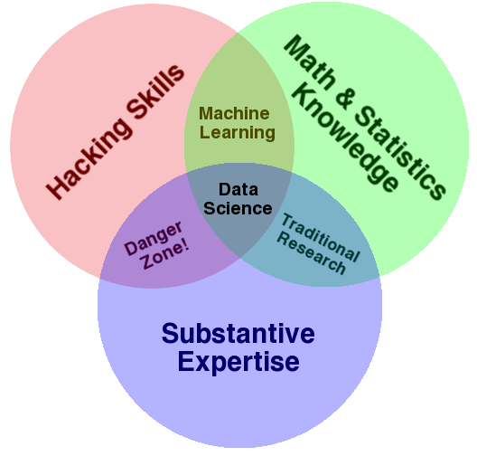
Data science
You can’t do machine learning without doing data science first
Data science means wrangling your data into a form you can use it in
Because any real data will never be useable in its raw form, you’ll need to clean it up, cut of the bad parts, …
In a way, machine learning is part of data science, because a good model can help you understand your data
Like what we did with the diamonds earlier

Slide 4
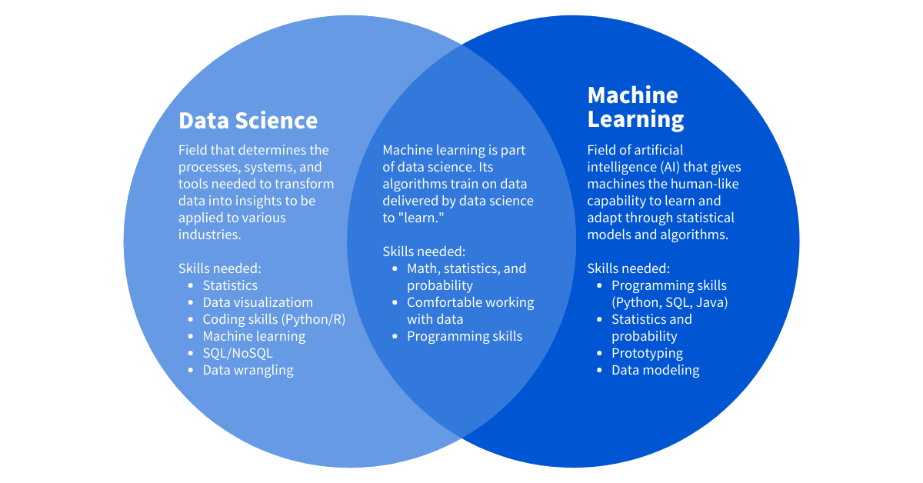
The overlap

Slide 5
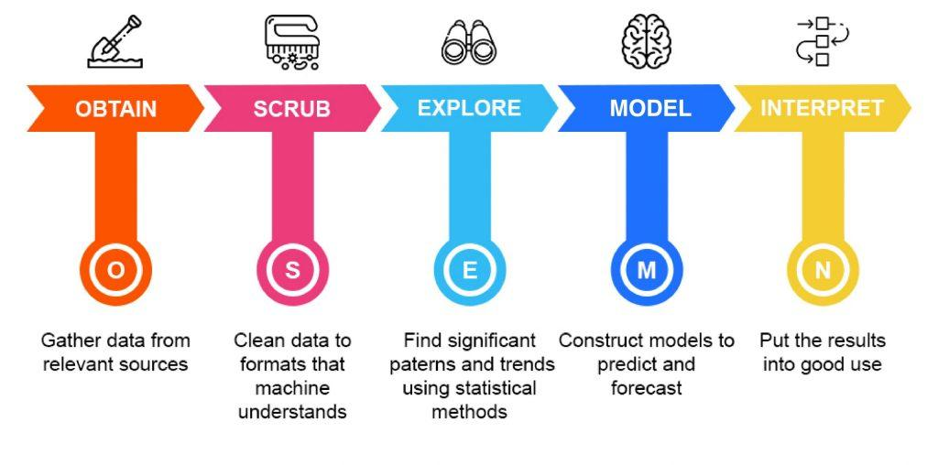
The data science process
The data science life cycle involves various roles, tools, and processes, which enables analysts to gain actionable insights. Typically, a data science project undergoes the following stages:
Notes:
https://thelead.io/data-science/5-steps-to-a-data-science-project-lifecycle

Slide 6
Step 1: Obtain
Query databases
Read Excel-files
Call API’s
Read CSV’s
…
Get and combine the data from anywhere you can
But: only use properly governed data
More is not better when more means less reliable

Slide 7

Step 1: Obtain
We’ve been storing huge amounts of data the past few years, but this data isn’t always publicly available
For example: a student internship was “scrape all the price data for holiday parks, so our client can use this data to better position themselves in the market.”
Very nice dataset by the way.
This process is called “scraping” and it’s really fun
It’s like a sudoku but with data and programming
Assignemt for students in the data science course: Scrape some festival line-ups and compare them

Slide 8
Step 2: Scrub
Are all dates recognized as dates?
Are all numbers recognized as numbers?
Is the information of different files correctly merged?
Does every datapoint translate to a single piece of information?
National Insurance Number: date of birth and gender
Street name and number: Split? Merge?
Are there missing values? How will you deal with them?
Amputation/imputation will be a big thing later in this presentation

Slide 9

Step 2: Scrub
Sometimes it feels like the easiest way of dealing with dates is simply storing “year”, “month” and “day” in a different variable (or field or…)
But your gut feeling is wrong: you should always use the correct datetime-datatypes
There are many, and for every language
And using them is always annoying in the beginning, but in the end it’s the only real viable option

Slide 10
Step 3: Explore
Try to make sense of all available data
Create some graphs, examine the distribution of all variables
Are there correlations between the data? Should there be?
High blood pressure in relation to height and weight
Do not assume causation!
If needed, go back to “Scrub”
Identify and label categorical data
Merge or split datapoints
Deal with outliers
Also: talk to the domain experts

Slide 11

Step 3: Explore
At this point you’ll also be needing a domain expert
With domain knowledge, you can begin to determine the features and target data that your model needs to make accurate predictions
Your data should be representative of the data that you are going to have when you use the model to make a prediction
[S]he’ll help you understand which fields are important and which not, which outliers are safe to throw away, how data can be imputed, …

Slide 12
Step 4: Model data
Create models that can explain or predict based upon the data you have imported
Classify using logistic regression
Predict using linear regression
Cluster using k-means or hierarchical clustering
(What we did in the previous chapter)

Slide 13
Step 5: Interpret the data
The ultimate goal of every data science-project
Test how the models we made generalize
Explain our findings to a non-domain specialist
Answer the questions we posed in the beginning
Do heavier cars always consume more gas?
In which season are there more insect-bites?
Tell a story using the data you were given.

Slide 14
Summing up
OSEMN | Description | Technologies used
Obtain | Gathering data from databases, the web, open data platforms like Kaggle, … | SQL, Web APIs, Web Scraping via Python libraries like Beautiful Soup, …
Scrub | Organising and tidying up the data, removing what is no longer needed, replacing what is missing and standardising the format across all the data collected. | Regex, Python Pandas library
Explore | Inspecting and analyzing the data with descriptive statistics (min-max-mean-median-correlations-distributions-…) and basic visualizations. | Python libraries like NumPy & Pandas Visualization libraries like MatPlotLib & Seaborn Visualization tools like Qlik, Tableau, PowerBI
Model | Setting up models to forecast future values or classify and group values. | Python libraries like SciKit
Interpret | Presenting the data to an audience. Delivering the results in such a way business questions are responded, and actionable insights are provided. | Python libraries like Matplotlib & Seaborn Javascript libraries like d3js Dashboarding tools like Qlik, Tableau, PowerBI

Slide 15

[Stolen from R]
Disclaimer: Sometimes we reuse slides
The following slides were reused from the course “Data science in R”
R is a very good language for statistics and it interacts really well with BI-tools
They’re being used by the same type of people
Programming in R is strange though
They explain when data is “tidy”, which is a big thing in R
We don’t have such a concept in Python, but we should (and at the very least be aware of it)

Slide 16
Same data, different formats
country year cases population
<chr> <int> <int> <int>
1 Afghanistan 1999 745 19987071
2 Afghanistan 2000 2666 20595360
3 Brazil 1999 37737 172006362
4 Brazil 2000 80488 174504898
5 China 1999 212258 1272915272
6 China 2000 213766 1280428583
2
country year type count
<chr> <int> <chr> <int>
1 Afghanistan 1999 cases 745
2 Afghanistan 1999 population 19987071
3 Afghanistan 2000 cases 2666
4 Afghanistan 2000 population 20595360
5 Brazil 1999 cases 37737
6 Brazil 1999 population 172006362
7 Brazil 2000 cases 80488
8 Brazil 2000 population 174504898
9 China 1999 cases 212258
10 China 1999 population 1272915272
11 China 2000 cases 213766
12 China 2000 population 1280428583
1
3
country year rate
* <chr> <int> <chr>
1 Afghanistan 1999 745/19987071
2 Afghanistan 2000 2666/20595360
3 Brazil 1999 37737/172006362
4 Brazil 2000 80488/174504898
5 China 1999 212258/1272915272
6 China 2000 213766/1280428583
4
country `1999` `2000`
* <chr> <int> <int>
1 Afghanistan 19987071 20595360
2 Brazil 172006362 174504898
3 China 1272915272 1280428583
country `1999` `2000`
* <chr> <int> <int>
1 Afghanistan 745 2666
2 Brazil 37737 80488
3 China 212258 213766

Slide 17
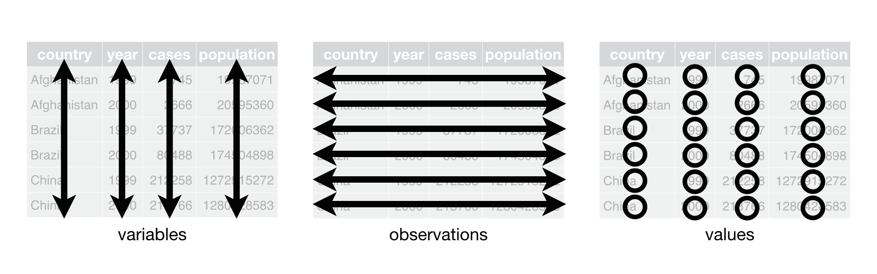
3 rules for data files
Each variable must have its own column.
Each observation must have its own row.
Each value must have its own cell.

Slide 18
Does each variable have its own column?
country year cases population
<chr> <int> <int> <int>
1 Afghanistan 1999 745 19987071
2 Afghanistan 2000 2666 20595360
3 Brazil 1999 37737 172006362
4 Brazil 2000 80488 174504898
5 China 1999 212258 1272915272
6 China 2000 213766 1280428583
2
country year type count
<chr> <int> <chr> <int>
1 Afghanistan 1999 cases 745
2 Afghanistan 1999 population 19987071
3 Afghanistan 2000 cases 2666
4 Afghanistan 2000 population 20595360
5 Brazil 1999 cases 37737
6 Brazil 1999 population 172006362
7 Brazil 2000 cases 80488
8 Brazil 2000 population 174504898
9 China 1999 cases 212258
10 China 1999 population 1272915272
11 China 2000 cases 213766
12 China 2000 population 1280428583
1
3
country year rate
* <chr> <int> <chr>
1 Afghanistan 1999 745/19987071
2 Afghanistan 2000 2666/20595360
3 Brazil 1999 37737/172006362
4 Brazil 2000 80488/174504898
5 China 1999 212258/1272915272
6 China 2000 213766/1280428583
4
country `1999` `2000`
* <chr> <int> <int>
1 Afghanistan 19987071 20595360
2 Brazil 172006362 174504898
3 China 1272915272 1280428583
country `1999` `2000`
* <chr> <int> <int>
1 Afghanistan 745 2666
2 Brazil 37737 80488
3 China 212258 213766

Slide 19
Each variable must have its own column
country year cases population
<chr> <int> <int> <int>
1 Afghanistan 1999 745 19987071
2 Afghanistan 2000 2666 20595360
3 Brazil 1999 37737 172006362
4 Brazil 2000 80488 174504898
5 China 1999 212258 1272915272
6 China 2000 213766 1280428583
country year type count
<chr> <int> <chr> <int>
1 Afghanistan 1999 cases 745
2 Afghanistan 1999 population 19987071
3 Afghanistan 2000 cases 2666
4 Afghanistan 2000 population 20595360
5 Brazil 1999 cases 37737
6 Brazil 1999 population 172006362
7 Brazil 2000 cases 80488
8 Brazil 2000 population 174504898
9 China 1999 cases 212258
10 China 1999 population 1272915272
11 China 2000 cases 213766
12 China 2000 population 1280428583
type and count are no true variables (= characteristics of the observation object)
country year rate
* <chr> <int> <chr>
1 Afghanistan 1999 745/19987071
2 Afghanistan 2000 2666/20595360
3 Brazil 1999 37737/172006362
4 Brazil 2000 80488/174504898
5 China 1999 212258/1272915272
6 China 2000 213766/1280428583
1999 and 2000 are not variables, they are values!
country `1999` `2000`
* <chr> <int> <int>
1 Afghanistan 19987071 20595360
2 Brazil 172006362 174504898
3 China 1272915272 1280428583
country `1999` `2000`
* <chr> <int> <int>
1 Afghanistan 745 2666
2 Brazil 37737 80488
3 China 212258 213766
One column contains two variables

Slide 20
Does each observation have its own row?
country year cases population
<chr> <int> <int> <int>
1 Afghanistan 1999 745 19987071
2 Afghanistan 2000 2666 20595360
3 Brazil 1999 37737 172006362
4 Brazil 2000 80488 174504898
5 China 1999 212258 1272915272
6 China 2000 213766 1280428583
2
country year type count
<chr> <int> <chr> <int>
1 Afghanistan 1999 cases 745
2 Afghanistan 1999 population 19987071
3 Afghanistan 2000 cases 2666
4 Afghanistan 2000 population 20595360
5 Brazil 1999 cases 37737
6 Brazil 1999 population 172006362
7 Brazil 2000 cases 80488
8 Brazil 2000 population 174504898
9 China 1999 cases 212258
10 China 1999 population 1272915272
11 China 2000 cases 213766
12 China 2000 population 1280428583
1
3
country year rate
* <chr> <int> <chr>
1 Afghanistan 1999 745/19987071
2 Afghanistan 2000 2666/20595360
3 Brazil 1999 37737/172006362
4 Brazil 2000 80488/174504898
5 China 1999 212258/1272915272
6 China 2000 213766/1280428583
4
country `1999` `2000`
* <chr> <int> <int>
1 Afghanistan 19987071 20595360
2 Brazil 172006362 174504898
3 China 1272915272 1280428583
country `1999` `2000`
* <chr> <int> <int>
1 Afghanistan 745 2666
2 Brazil 37737 80488
3 China 212258 213766

Slide 21
Each observation must have its own row
country year type count
<chr> <int> <chr> <int>
1 Afghanistan 1999 cases 745
2 Afghanistan 1999 population 19987071
3 Afghanistan 2000 cases 2666
4 Afghanistan 2000 population 20595360
5 Brazil 1999 cases 37737
6 Brazil 1999 population 172006362
7 Brazil 2000 cases 80488
8 Brazil 2000 population 174504898
9 China 1999 cases 212258
10 China 1999 population 1272915272
11 China 2000 cases 213766
12 China 2000 population 1280428583
country year cases population
<chr> <int> <int> <int>
1 Afghanistan 1999 745 19987071
2 Afghanistan 2000 2666 20595360
3 Brazil 1999 37737 172006362
4 Brazil 2000 80488 174504898
5 China 1999 212258 1272915272
6 China 2000 213766 1280428583
2 rows per observation
country year rate
* <chr> <int> <chr>
1 Afghanistan 1999 745/19987071
2 Afghanistan 2000 2666/20595360
3 Brazil 1999 37737/172006362
4 Brazil 2000 80488/174504898
5 China 1999 212258/1272915272
6 China 2000 213766/1280428583
Observations spread across two tables
country `1999` `2000`
* <chr> <int> <int>
1 Afghanistan 19987071 20595360
2 Brazil 172006362 174504898
3 China 1272915272 1280428583
country `1999` `2000`
* <chr> <int> <int>
1 Afghanistan 745 2666
2 Brazil 37737 80488
3 China 212258 213766

Slide 22
Does each value have its own cell?
country year cases population
<chr> <int> <int> <int>
1 Afghanistan 1999 745 19987071
2 Afghanistan 2000 2666 20595360
3 Brazil 1999 37737 172006362
4 Brazil 2000 80488 174504898
5 China 1999 212258 1272915272
6 China 2000 213766 1280428583
2
country year type count
<chr> <int> <chr> <int>
1 Afghanistan 1999 cases 745
2 Afghanistan 1999 population 19987071
3 Afghanistan 2000 cases 2666
4 Afghanistan 2000 population 20595360
5 Brazil 1999 cases 37737
6 Brazil 1999 population 172006362
7 Brazil 2000 cases 80488
8 Brazil 2000 population 174504898
9 China 1999 cases 212258
10 China 1999 population 1272915272
11 China 2000 cases 213766
12 China 2000 population 1280428583
1
3
country year rate
* <chr> <int> <chr>
1 Afghanistan 1999 745/19987071
2 Afghanistan 2000 2666/20595360
3 Brazil 1999 37737/172006362
4 Brazil 2000 80488/174504898
5 China 1999 212258/1272915272
6 China 2000 213766/1280428583
4
country `1999` `2000`
* <chr> <int> <int>
1 Afghanistan 19987071 20595360
2 Brazil 172006362 174504898
3 China 1272915272 1280428583
country `1999` `2000`
* <chr> <int> <int>
1 Afghanistan 745 2666
2 Brazil 37737 80488
3 China 212258 213766

Slide 23
Each value must have its own cell
country year cases population
<chr> <int> <int> <int>
1 Afghanistan 1999 745 19987071
2 Afghanistan 2000 2666 20595360
3 Brazil 1999 37737 172006362
4 Brazil 2000 80488 174504898
5 China 1999 212258 1272915272
6 China 2000 213766 1280428583
country year type count
<chr> <int> <chr> <int>
1 Afghanistan 1999 cases 745
2 Afghanistan 1999 population 19987071
3 Afghanistan 2000 cases 2666
4 Afghanistan 2000 population 20595360
5 Brazil 1999 cases 37737
6 Brazil 1999 population 172006362
7 Brazil 2000 cases 80488
8 Brazil 2000 population 174504898
9 China 1999 cases 212258
10 China 1999 population 1272915272
11 China 2000 cases 213766
12 China 2000 population 1280428583
country year rate
* <chr> <int> <chr>
1 Afghanistan 1999 745/19987071
2 Afghanistan 2000 2666/20595360
3 Brazil 1999 37737/172006362
4 Brazil 2000 80488/174504898
5 China 1999 212258/1272915272
6 China 2000 213766/1280428583
country `1999` `2000`
* <chr> <int> <int>
1 Afghanistan 19987071 20595360
2 Brazil 172006362 174504898
3 China 1272915272 1280428583
country `1999` `2000`
* <chr> <int> <int>
1 Afghanistan 745 2666
2 Brazil 37737 80488
3 China 212258 213766
One cell contains two values

Slide 24
Problems in data
The data you get will have issues
Contains outliers
Ordinal and nominal (important to figure out)
Contains missing values
Has bias

Slide 25
Outliers
Outliers are observations or data points that significantly deviate from the rest of the data, extreme values that are distinctively different from the majority of the dataset
Measurement errors
Data corruption
Genuinely unusual observations
Can distort the results of statistical analyses, leading to incorrect conclusions or misleading interpretations

Slide 26
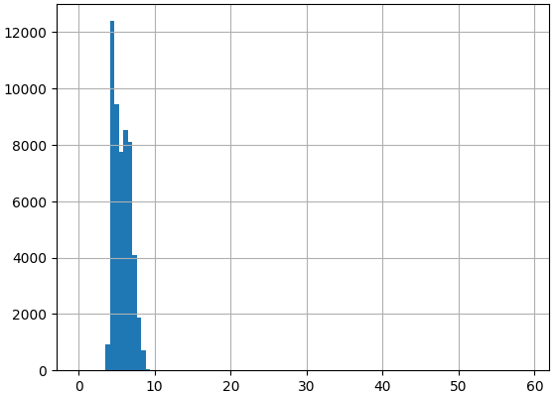
Outliers
This is the histogram for the Y-size of about 50.000 diamonds
All are between 3 and 10 mm, but why is the graph so big?
Because there is one diamond in the set with a Y-value of around 60
For reference: the biggest diamond in the world is 10x6 cm
This diamond’s price is $12k
(Something is wrong there)

Slide 27
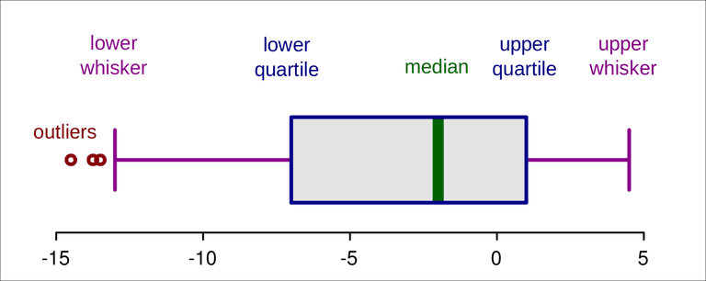
Outliers
Outliers can be seen in histograms, but box-plots are easier
The green line is the median, the outside of the box is the q1 and q3
25% of data is below the q1-value (quartile 1)
The median (q2) is the center value
IQR = q3 – q1
Outliers:
Below q1 – 1.5 x IQR
Above q3 + 1.5 x IQR
Where the lines end!

Slide 28
Outliers
IQR: Inter quartile range
Range between q1 and q3
Unaffected by extreme outliers
Standard deviation:
Average distance to the mean
Is affected by extreme outliers
You could calculate outliers using average ± 3 x standard deviation

Slide 29
Outliers: how to handle
Removing outliers: easiest, but also quite harsh
Transformation: if the data is logarithmic you should transform it, the outliers may not seem so outlierly after all
Winsorization or clipping: capping the extreme values at a predefined threshold
Creating separate models: outliers may represent a distinct subset of data that requires separate modeling or analysis. Create a separate models for these datapoints

Slide 30
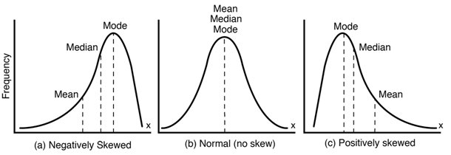
Data skewing
Not a problem to fix, but interesting none the less
Median = average: normal distribution
There were some students who didn't get it, and they got bad grades
Most students got a mediocre value, they make up the bulk of grades
Some students managed to excel, getting really high grades
Median > average
Test was to easy, almost everybody got good grades
Average > median
Test was to hard, only the whizz-kids got good grades

Slide 31
Data skewing
Examples of negative (left) skewing
Age of retirement (most people retire around 65, a few much earlier).
Distances of long olympic long jump
Age of dying
Examples of positive (right) skewing
Income
Housing prices
Hospital stay duration
Amount of pets people own

Slide 32
Categorical data
Gender: Categorized as male or female.
Marital Status: Categorized as single, married, divorced, widowed, etc.
Educational Level: Categorized as high school, college, graduate degree, etc.
Hair Color: Categorized as black, brown, blonde, red, etc.
Vehicle Type: Categorized as car, truck, motorcycle, bicycle, etc.
Cannot be subjected to numerical operations or calculations, such as addition or multiplication
Use chi-square tests, contingency tables, and frequency distributions

Slide 33
Ordinal and nominal
Ordinal: the fields have an order
T-shirt sizes, ratings, education level, …
The intervals between categories may not be uniform or measurable
Nominal: no inherent order or ranking
Gender, colors, marital status, types of fruit, …
Each category is distinct and does not have any relative position or hierarchy

Slide 34
One hot encoding
Suppose we have 3 types of fruit (apple, banana and orange)
If we store “1” for apple, “2” for banana and “3” for orange, a model may treat this as a numerical value
An orange is worth three apples
This is wrong, but the model will train upon this
Solution: three columns (called apple, banana and orange)
Every row gets a one in the correct column and zero in the others
Pro: an apple isn’t less more than an orange anymore
Con: increase of dimensionality (and memory-requirements for models)

Slide 35
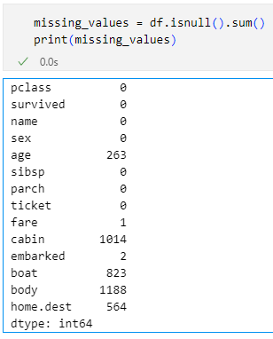
Missing values
Not all data is always known
There can be many reasons for this:
Never measured
Can be calculated
Wrongly stored
You’ll need a domain expert for most of the solutions to this problem

Slide 36
Missing values: Amputation
Easiest solution is simply deleting the data
The row
A record that has to much missing data
Note: you also delete the data you do have
The column
One measurement that won’t help in the models
Note: again, you also delete the data you do have
Amputation is often the safest way of dealing with outliers, especially if you don’t have too much actual data in the row/column
Note: Outliers: always delete the row, never the column
Notes:
In titanic: delete the 1 row without a fare, and the column “cabin”

Slide 37
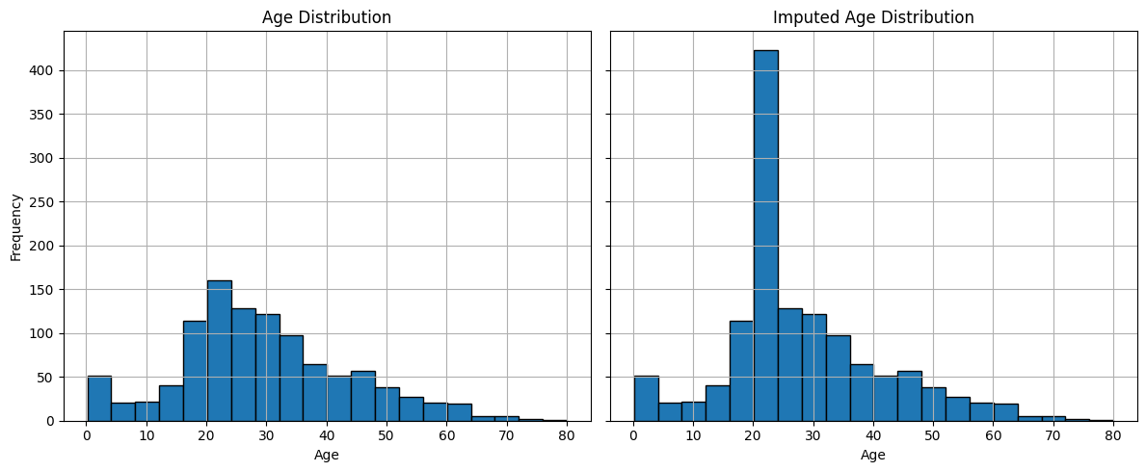
Missing values: Imputing
Sometimes you can make a good guess on what the value should be
Based only on the column itself
Mean/Median/Mode Imputation
Beware: you’ll get spikes in your data
Example: fill in the missing ages in Titanic with the mode of age

Slide 38
Missing values: Imputing
Based on the rest of the data as well:
Regression Imputation
K-Nearest Neighbors (KNN) Imputation: replace missing values with the average of the values from the nearest neighbors
Multiple Imputation: combine different models
SimpleImputer
But beware: if you predict the age of people on titanic based on their fare, you strengthen this connection and make it appear stronger in the final model than it actually is
… which of course will lead to a lower quality model when doing inference

Slide 39
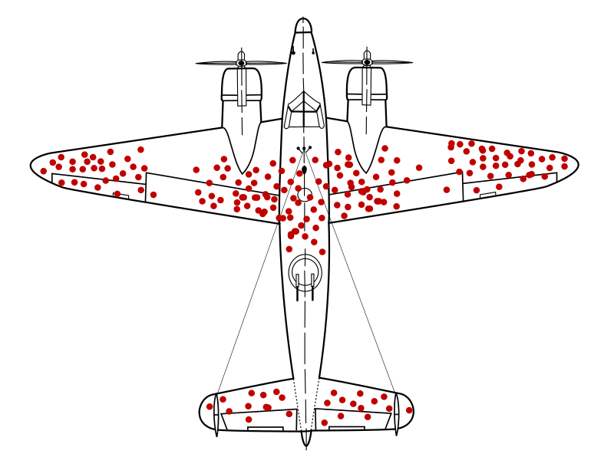
Notes:
https://en.wikipedia.org/wiki/Survivorship_bias
https://www.youtube.com/watch?v=P9WFpVsRtQg

Slide 40
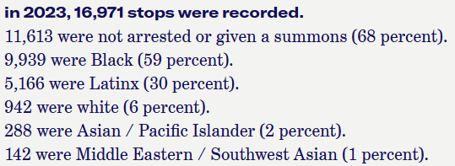
Bias
Looking at this data, what percentage of black people carrying a joint will get caught? And what percentage of white people?
And what will show up in the statistics?
And what will the cops base their decision on who to stop and frisk on?

Slide 41
Bias
More types of Bias:
Sampling Bias: Non-representative sample.
Selection Bias: Influenced selection of data points.
Measurement Bias: Errors in measurement.
Reporting Bias: Systematic difference in reporting.
Confirmation Bias: Selective search for confirming information.
Algorithmic Bias: Discrimination in machine learning models.
Survivor Bias: Focus on surviving data points.
Snoop Bias: Test data influencing training process.
Mitigation: Random sampling, rigorous study designs, careful measurement, transparency, and regular bias assessments.

Slide 42
Bias
Bias is often linked to preset notions that are continuously confirmed because we choose to ignore all information that doesn’t confirm our information
You wore a blue shirt and all of the sudden everybody is wearing a blue shirt!
This often ends up in our data, and it’s something to be aware of, but not something we can easily solve
Fairness-Constrained Optimization: Add fairness metrics (like demographic parity, equal opportunity) as constraints in the loss function.
Adversarial Debiasing: Train the model to make predictions while simultaneously trying to prevent it from encoding sensitive information.
Prejudice Remover Regularizer: Penalize the model for using sensitive attributes in predictions.
Use explainable AI (XAI) tools like SHAP or LIME to detect biased reasoning.
It’s the reason the EU has rules on when to use AI models

Slide 43
Bias we can handle
We want to detect fraudulent transactions, but only 1% of the data is fraudulent
We want to train the “what animal is on the savannah”, but the data is:
50 zebras, 40 wildebeests, 70 antelopes, 2 leopards
A model that ignores leopards can get an accuracy of 98,8%
Solution:
Get more data
Weight the observations (leopards get more weight than the others)
Use a propensity score (make sure leopards are selected more when training)
Simulate our augment missing data

Slide 44
Snoop Bias
When information from the test dataset accidentally influences the training process
letting the model "cheat" by learning patterns it should not know in advance
Often leads to performance results that seem overly optimistic
These results are misleading: when the model encounters fresh, unseen data in practical applications (inference), it stumbles because it has essentially memorized the test data
The Human Bias Risk: our own human tendency to recognize patterns can influence how we handle test datasets
We might unintentionally use knowledge from the test data while choosing features or selecting models
This seemingly harmless "peek" can skew the entire development process, resulting in a model that appears effective during testing but fails miserably in real-world applications
It's crucial to keep the test set entirely off-limits until the final evaluation.

Slide 45


Scaling
The problem: length is between 1.5 and 2.2, weight between 50 and 140
A model may see the bigger number as more important
Scaling: adjust range of data to fit between 0 and 1 (or something similar)
Min-max scaling:
Standarization:
Will provide you with data that is easier for algorithms to compare

Slide 46
Scaling
But is it needed, the data is in separate columns after all…
Yes:
K-Nearest Neighbors (KNN): Uses Euclidean distance; scale matters directly
SVM: Hyperplane depends on distance metrics
Logistic Regression: Faster convergence, better regularization
Gradient Descent (e.g., in neural nets): Helps gradient flow and training speed
No:
Tree-based models: Splits are based on feature thresholds, not distance
Naive Bayes: Works with probabilities, not distances

Slide 47
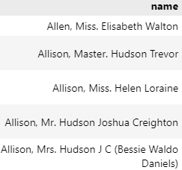
Feature engineering
In titanic, what’s the difference between “Miss” and “Mrs.”? And what is a “Master.”?
Feature engineering: creating, selecting, transforming, or encoding data into formats that maximize a model’s ability to learn patterns
Example
Suppose you're building a model to predict customer churn. Raw data might include:
last_login_date, total_spent, account_creation_date
Feature engineering could turn this into:
days_since_last_login, average_spend_per_month, account_age_in_days
These derived features may carry much more predictive value than the raw inputs.

Slide 48
Feature engineering
Why Feature Engineering Matters
Boosts model accuracy
Helps models generalize better
Allows you to inject domain expertise into the model
Can reduce the need for complex models
Another example:
last_purchase_date, number_of_site_visits, signup_date, total_items_viewed, is_subscribed_to_newsletter
is_engaged_customer: has made >3 purchases in the last 6 months
views_per_visit: total_items_viewed / number_of_site_visits

Slide 49
Summary
Learning to do machine learning is kind of like motor repairs:
When learning about it in class it’s all clean and ready
When in the shop everything is greasy and you’ll spend more time cleaning the engine than working on it
This is normal, because it’s to easy to store data
People with a big attic rarely have an ordered attic because they don’t need to save space, they can just dump it all in there
A good clean will make your models better
Cleaning to much will make your models worse
Amputating, imputing both have their challenges

